Slide 1



Machine learning Classification project: BY Group 3 Team members : Rajput siddhi Thakur Swetha Bharath Vaddapalli murali Shaik Anas
Aurora Degree & PG college

Slide 2
INDEX
CONTENT
Background, objective and path
Variable description
Data pre-processing
EDA
Machine learning algorithms
Conclusion
Appendix
SLIDES NUMBERS
1
2
3
4,5,6,7
8,9,10,11,12,13,14,15,16
17
19,20,21,22,23

Slide 3
BACKGROUND
1
The background of customer churn prediction can be traced back to the growing importance of customer retention in today's competitive marketplaces. Retaining existing customers is often more cost-effective than acquiring new ones, making it essential for businesses to identify and address factors that lead to customer.
OBJECTIVE
The objective is to analysis and predict the customer churn in a Iranian telecom company.
THE PATH
Team followed standard Machine Learning algorithm development process to fit the best model to predict the customer churn.

Slide 4
VARIABLE DESCRIPTION
2
VARIABLES | DESCRIPTION
CALL FAILURES | number of call failures
Complains | binary (0: no complaint, 1: complaint)
SUBSCRIPTION LENGTH | total months of subscription
CHARGE AMOUNT | ordinal attribute (0: lowest amount, 9: highest amount)
SECONDS OF USE | total seconds of calls
FREQUENCY OF USE | total number of calls
FREQUENCY OF SMS | total number of text messages
DISTINCT CALLED NUMBERS: | total number of distinct phone calls
AGE GROUP | ordinal attribute (1: younger age, 5: older age)
TARIFF PLAN | binary (1: pay as you go, 2: contractual)
STATUS | binary (1: active, 2: non-active)
Churn (TARGET VARIABLE) | binary (1: churn, 0: non-churn)-class label
Customer Value | the calculated value of customer

Slide 5
DATA PRE –PROCESSING .
3
DATA CLEANING
As there are two age columns in data set we dropped one age column.
HANDLING MISSING VALUES
All columns in data set are categorical .
In columns tariff plan and status column the unique values are 1 & 2 .
so, we replaced the value ‘2’ with ‘0’ in both the colums because both the columns are not continious
DUMMY VARIABLE ENCODING

Slide 6
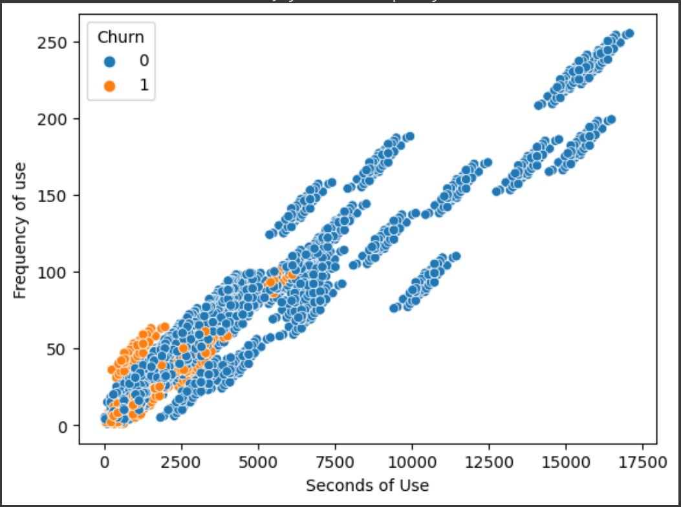
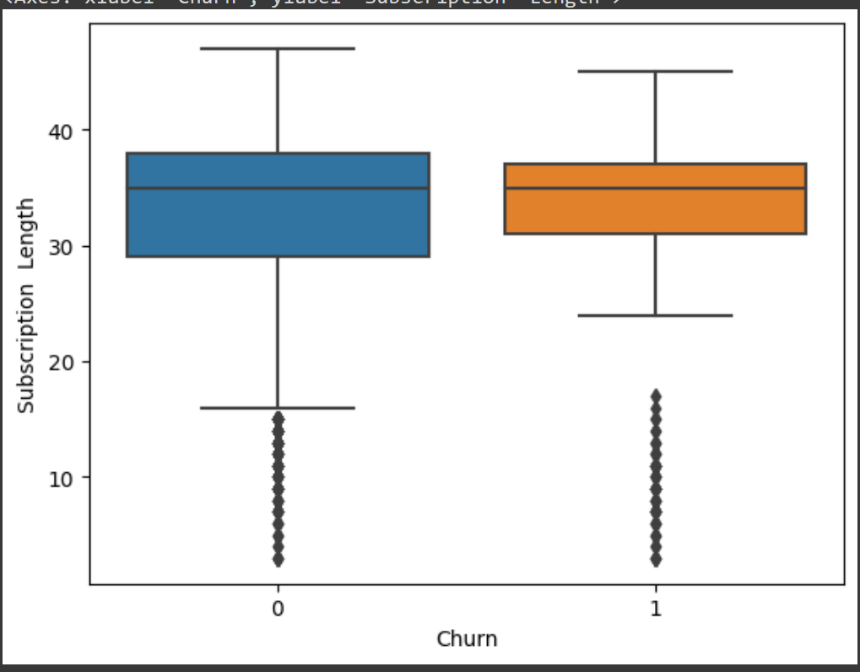
EXPLORATORY DATA ANALYSIS (EDA):=
4
SCATTER PLOT
BOX PLOT

Slide 7
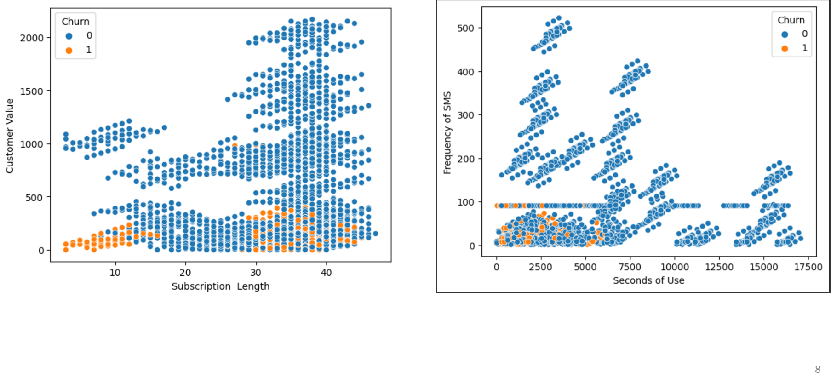
5

Slide 8
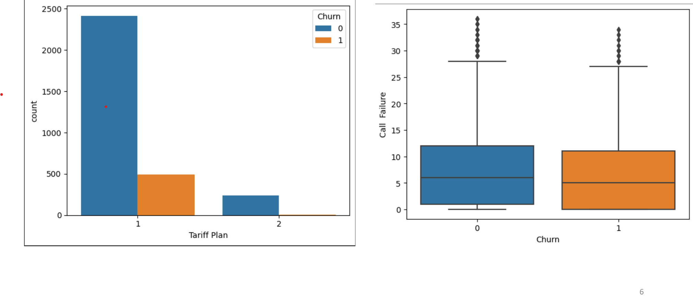
6

Slide 9
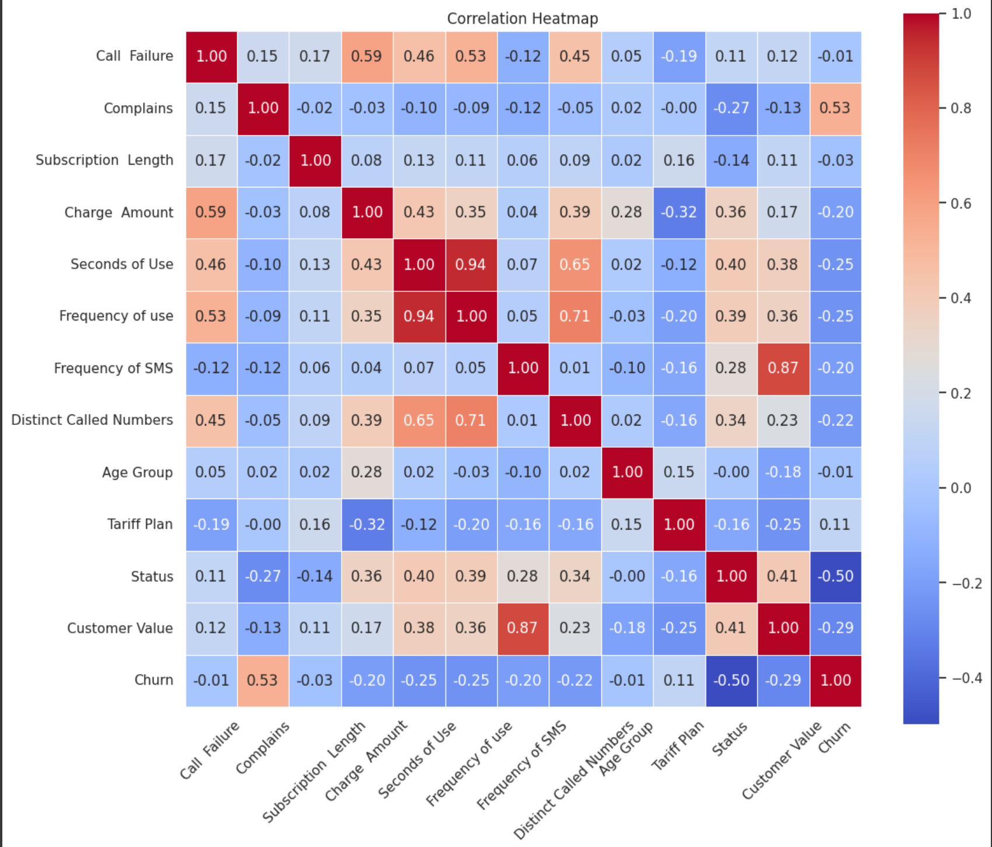
HEAT MAP
7

Slide 10
LOGISTIC REGRESSION
MACHINE LEARNING ALGORITHAMS:=
8
TRAIN TEST RATIO | ACCURACY SCORE
60-40 | 0.8896
65-35 | 0.8884
70-30 | 0.8835
75-25 | 0.8794
80-20 | 0.8730

Slide 11
SUPPORT VECTOR MACHINE (SVM)
9
TRAIN TEST RATION | Accuracy Score
60-40 | 0.8746
65-35 | 0.8676
70-30 | 0.8666
75-25 | 0.8654
80-20 | 0.8492

Slide 12
K-NEREST NEIGHOR(KNN)
10
TRAIN TEST RATIO | ACCURACY SCORE | N_neighbours
60-40 | 0.8309 | 3
60-40 | 0.8404 | 5
60-40 | 0.8428 | 7
65-35 | 0.8377 | 3
65-35 | 0.8413 | 5
65-35 | 0.8495 | 7
70-30 | 0.8391 | 3
70-30 | 0.8349 | 5
70-30 | 0.8391 | 7
75-25 | 0.8375 | 3
75-25 | 0.8286 | 5
75-25 | 0.8324 | 7
80-20 | 0.8412 | 3
80-20 | 0.8253 | 5
80-20 | 0.8349 | 7

Slide 13
GRAIDENT BOOSTING
11
TRAIN TEST RATIO | ACCURACY SCORE | Max _depth
60-40 | 0.90 | 3
60-40 | 0.91 | 5
60-40 | 0.92 | 7
65-35 | 0.90 | 3
65-35 | 0.92 | 5
65-35 | 0.93 | 7
70-30 | 0.89 | 3
70-30 | 0.91 | 5
70-30 | 0.92 | 7
75-25 | 0.88 | 3
75-25 | 0.90 | 5
75-25 | 0.92 | 7
80-20 | 0.88 | 3
80-20 | 0.91 | 5
80-20 | 0.91 | 7

Slide 14
DECISION TREE
12
TRAIN TEST RATIO | ACCURACY SCORE | Max _depth
60-40 | 0.8952 | 3
60-40 | 0.9126 | 5
60-40 | 0.9238 | 7
65-35 | 0.8957 | 3
65-35 | 0.9174 | 5
65-35 | 0.9292 | 7
70-30 | 0.8878 | 3
70-30 | 0.9089 | 5
70-30 | 0.9216 | 7
75-25 | 0.8832 | 3
75-25 | 0.9111 | 5
75-25 | 0.9213 | 7
80-20 | 0.8793 | 3
80-20 | 0.9015 | 5
80-20 | 0.9174 | 7

Slide 15
RANDOM FOREST
13
TRAIN TEST RATIO | ACCURACY SCORE | Max _depth
60-40 | 0.8952 | 3
60-40 | 0.9079 | 5
60-40 | 0.9325 | 7
65-35 | 0.8957 | 3
65-35 | 0.9084 | 5
65-35 | 0.9274 | 7
70-30 | 0.8878 | 3
70-30 | 0.9005 | 5
70-30 | 0.9312 | 7
75-25 | 0.8832 | 3
75-25 | 0.8972 | 5
75-25 | 0.9251 | 7
80-20 | 0.8793 | 3
80-20 | 0.8904 | 5
80-20 | 0.9142 | 7

Slide 16
ADA BOOST
14
TRAIN TEST RATIO | ACCURACY SCORE | Learning rate | N Estimators
65-35 | 0.8776 | 0.01 | 100
65-35 | 0.8948 | 0.01 | 500
65-35 | 0.8957 | 0.1 | 100
65-35 | 0.9138 | 0.1 | 500
70-30 | 0.8719 | 0.01 | 100
70-30 | 0.8867 | 0.01 | 500
70-30 | 0.8857 | 0.1 | 100
70-30 | 0.9079 | 0.1 | 500
75-25 | 0.8642 | 0.01 | 100
75-25 | 0.8819 | 0.01 | 500
75-25 | 0.8832 | 0.1 | 100
75-25 | 0.9073 | 0.1 | 500
80-20 | 0.8603 | 0.01 | 100
80-20 | 0.8777 | 0.01 | 500
80-20 | 0.8777 | 0.1 | 100
80-20 | 0.9031 | 0.1 | 500

Slide 17
XG BOOST
15
TRAIN TEST RATIO | ACCURACY SCORE | Max _depth
60-40 | 0.93 | 3
60-40 | 0.94 | 5
60-40 | 0.95 | 7
65-35 | 0.94 | 3
65-35 | 0.95 | 5
65-35 | 0.95 | 7
70-30 | 0.93 | 3
70-30 | 0.94 | 5
70-30 | 0.94 | 7
75-25 | 0.93 | 3
75-25 | 0.95 | 5
75-25 | 0.95 | 7
80-20 | 0.93 | 3
80-20 | 0.94 | 5
80-20 | 0.94 | 7

Slide 18
16
COMPARISION OF IMPLEMENTED MODELS :
MODEL | ACCURACY SCORE
Logistic regression | 0.8896
Support Vector Machine (SVM) | 0.8676
KNN | 0.8495
Gradient Boosting | 0.93
Decision Tree | 0.9292
Random forest | 0.9325
ADA Boost | 0.9138
XG Boost | 0.95
Highest accuracy score

Slide 19
17
CONCLUSION:=
For Customer Churn prediction , we performed five types of machine learning algorithms: Logistic Regression, SVM , KNN, Bagging and Boosting.
From all the analysis and implementations of the algorithm, we found the best results in Boosting algorithm i.e. in the XG Boost algorithm for 75-25 train-test ratio ( parameters : Max depth=5, N estimators=100, learning rate=0.1) with accuracy of 0.95 which is the highest accuracy among all the other algorithms.
So, here we can conclude that XG Boost Algorithm can be considered the best model for the given Customer Churn prediction dataset.

Slide 20
RAJPUT SIDDHI THAKUR SWETHA BHARATH VADDEPALLI MURALI SHAIK ANAS
18
THANK YOU:=

Slide 21
19
Appendix

Slide 22
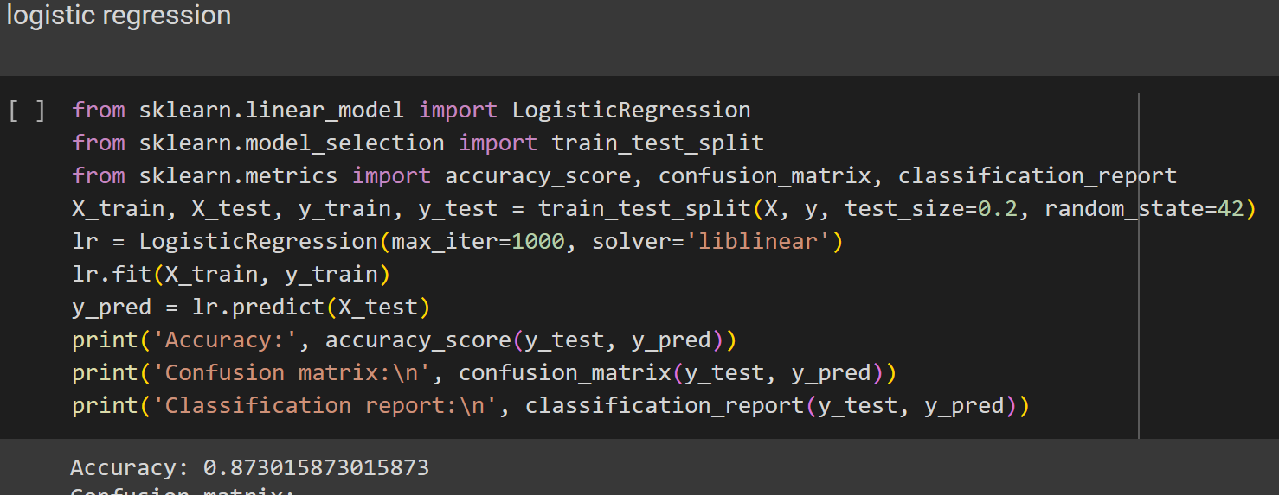
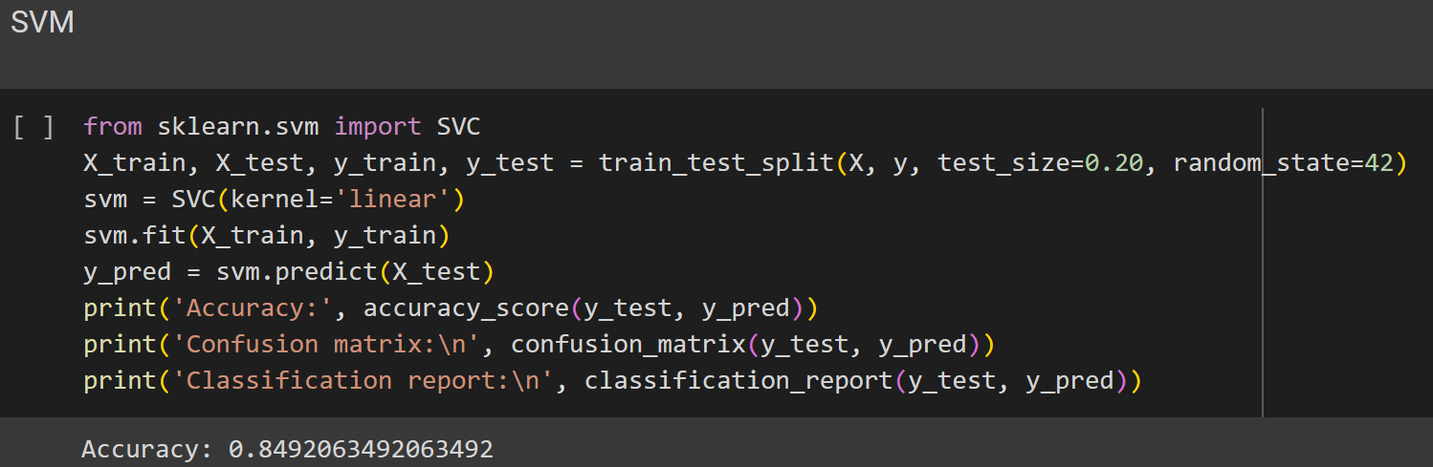
20
ALGORITHMS:=

Slide 23
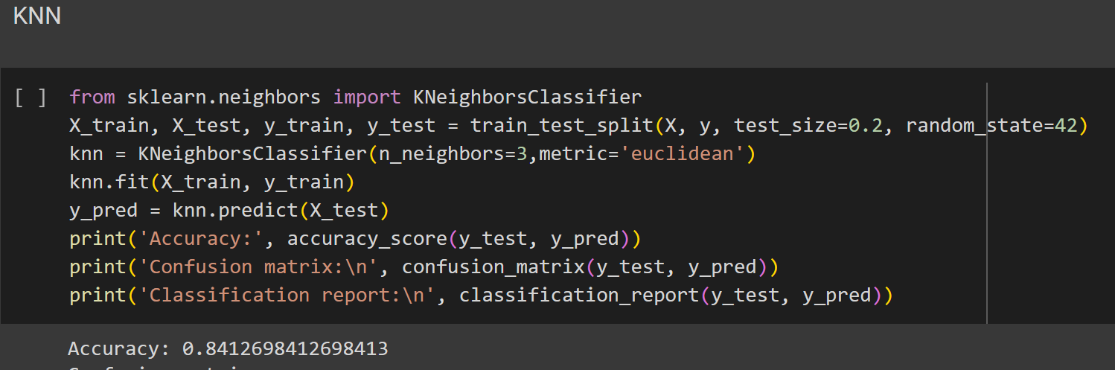
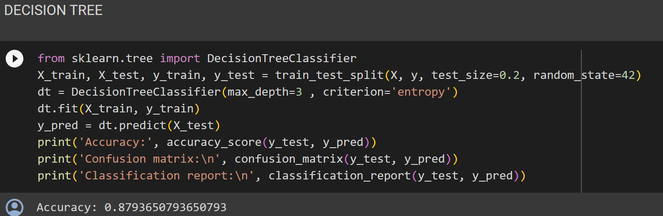
21

Slide 24
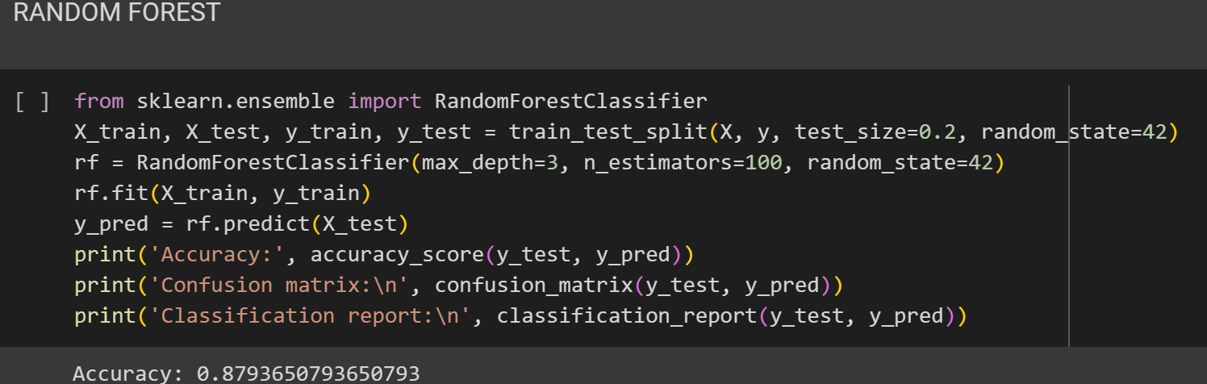
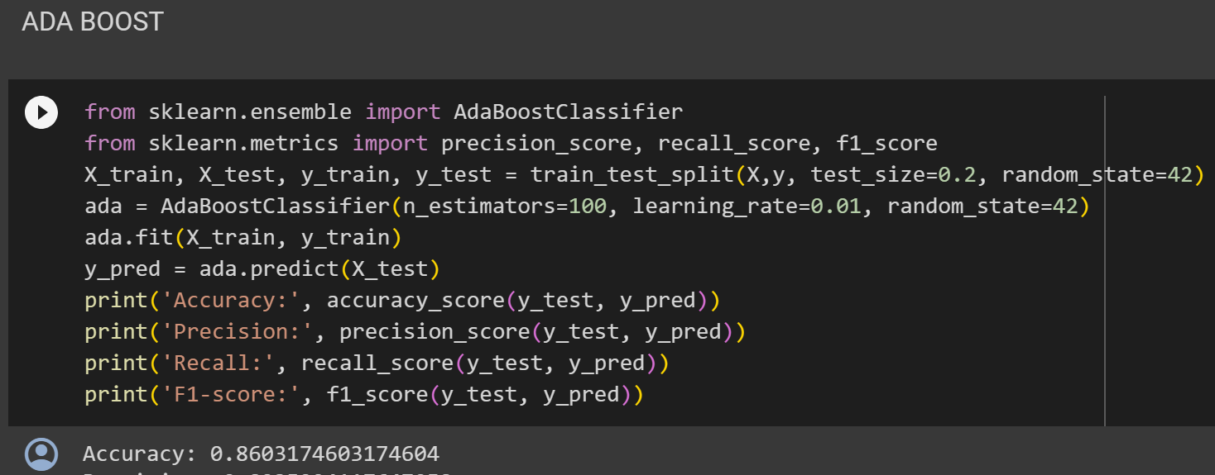
22

Slide 25
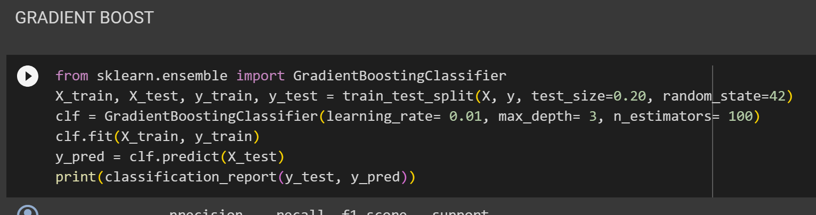
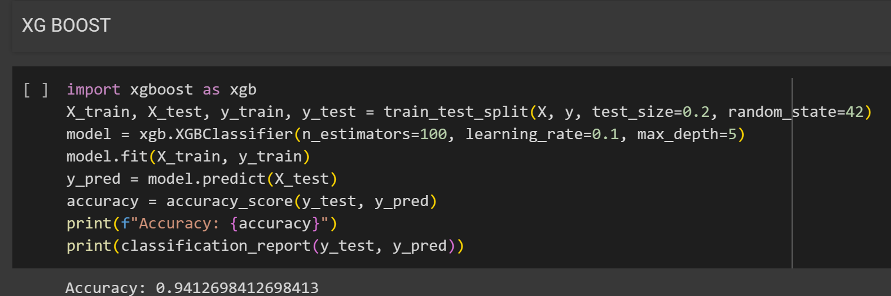
23

